Slide 1
Mood Disorders
By
Mohammed Fadhil Ali

Slide 2
Introduction
What are mood disorders?
are a group of common psychiatric disorders characterized by disturbances of emotion, person exhibititing mood disorders demonstrate a range of emotion from intense elation to severe depression

Slide 3
Depression is likely the oldest and still one of the most frequently diagnosed psychiatric illnesses.
A feeling of sadness or downheartedness, is common among healthy people and considered to be normal response to everyday disappointments in life.
These episodes are short-lived as the individual adapts to the loss, change, or failure (real or perceived) that has been experienced.
Pathological depression occurs when adaptation is ineffective.

Slide 4
Causes of Mood Disorders
The cause of mood disorders is not fully understood, but an imbalance in brain neurotransmitters is likely to play a role.
Sometimes mood disorders may be related to a medical condition, substance abuse, life events, or other causes.

Slide 5
What are the risk factors for mood disorders?
Adolescence
Alcohol or drug use
Certain medical conditions such as hypothyroidism (underactive thyroid) or chronic pain
Certain medications
Family history of mood disorders
Female gender
Isolation from other people
Personal history of sleep disorders
life event such as divorce or death in the family

Slide 6
Definitions
Mood : is a pervasive and sustained emotion that may have a major influence on a person’s perception of the world. Examples of mood include depression, joy, elation, anger .
Affect : is described as the emotional reaction associated with an experience.
Depression : An alteration in mood that is expressed by feelings of sadness, despair, and pessimism. There is a loss of interest in usual activities, and somatic symptoms may be evident. Changes in appetite and sleep patterns are common.

Slide 7
Types of Depressive Disorders
Major Depressive Disorder
Persistent Depressive Disorder (Dysthymia)
Postpartum Depression
Major Depressive Disorder With Seasonal Pattern
Substance/Medication-Induced Depressive Disorder
Premenstrual Dysphoric Disorder
Depressive Disorder Due to Another Medical Condition

Slide 8
Major Depressive Disorder
A major depressive episode lasts at least 2 weeks , during which the person experiences a depressed mood or loss of pleasure in nearly all activities

Slide 9
Evidence will show impaired social and occupational functioning that has existed for at least 2 weeks.
The diagnosis of MDD is specified according to whether it is single episode(the individual’s first encounter with a major depressive episode) or recurrent (the individual has a history of previous major depressive episodes).
The diagnosis will also identify the degree of severity of symptoms (mild, moderate, or severe) and whether there is evidence of psychotic or catatonic features.
The presence of anxiety and severity of suicide risk may also be noted.

Slide 10
Symptoms of Major Depressive Disorder
• Depressed mood
• Anhedonia
• Unintentional weight change of 5% or more in a month
• Change in sleep pattern
• Agitation or psychomotor retardation
• Tiredness
• Worthlessness or guilt inappropriate to the situation (possibly delusional)
• Difficulty thinking, focusing, or making decisions
• Hopelessness, helplessness, and/or suicidal ideation

Slide 11
Persistent Depressive Disorder (Dysthymia)
is characterized by at least 2 years of depressed mood for more days than not with some additional, less severe symptoms that do not meet the criteria for a major depressive episode.

Slide 12
NURSING INTERVENTIONS for Depression
• Provide the safety of the client and others.
• Institute suicide precautions if indicated.
• Begin a therapeutic relationship by spending non demanding time with the client.
• Promote completion of activities of daily living
• Establish adequate nutrition and hydration.
• Promote sleep and rest.
• Engage the client in activities.
• Encourage the client to verbalize and describe emotions.
• Work with the client to manage medications and side
effects.

Slide 13
Mania
Mania : is a distinct period during which mood is abnormally and persistently elevated, expansive, or irritable. Typically, this period lasts about 1 week

Slide 14
Hypomania
is a period of abnormally and persistently elevated, expansive, or irritable mood lasting 4 days and including three or four of the additional symptoms, not impair the person’s ability to function, not need hospitalization

Slide 15
The manic episode: grandiosity, decreased need for sleep, pressured speech, flight of ideas, distractibility, increased involvement in psychomotor agitation. and excessive involvement in pleasure-seeking activities .
Some people also exhibit delusions and hallucinations during a manic episode, need hospitalization

Slide 16
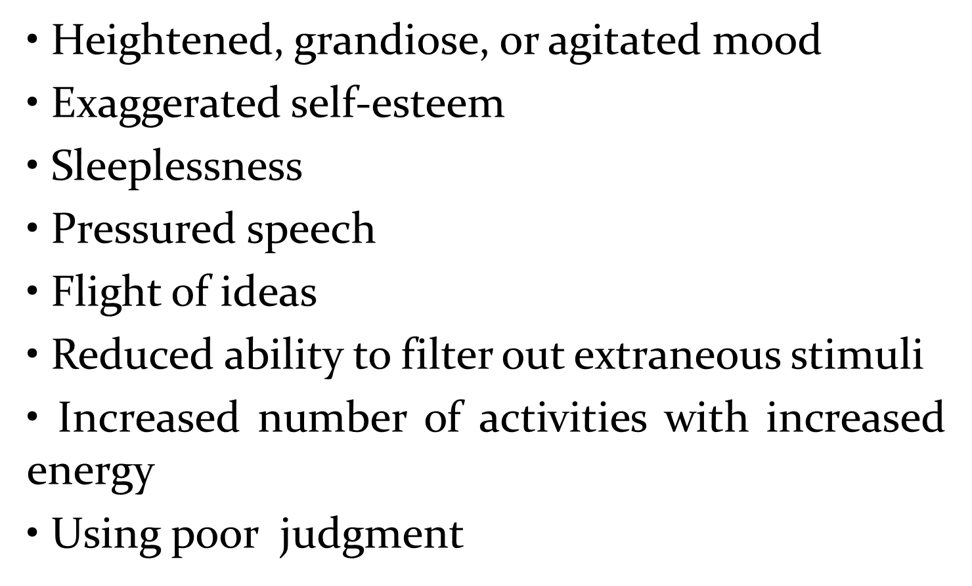
Typical Symptoms of Mania

Slide 17
NURSING INTERVENTIONS for Mania
• Provide for client’s physical safety and those around.
• Set limits on client’s behavior when needed.
• Remind the client to respect distances between self and others.
• Use short, simple sentences to communicate.
• Clarify the meaning of client’s communication.
• Frequently provide finger foods that are high in calories and protein.
• Promote rest and sleep.
• Protect the client’s dignity when inappropriate behavior occurs.
• Channel client’s need for movement into socially acceptable motor activities.

Slide 18
Bipolar disorder
is diagnosed when a person’s mood cycles between extremes of mania and depression.

Slide 19
Type of Bipolar disorder
Bipolar I disorder : one or more manic or mixed episodes usually accompanied by major depressive episodes.
Bipolar II disorder : one or more major depressive episodes accompanied by at least one hypomanic episode but no manic episode.

Slide 21
Thank You For Listening

