Slide 1
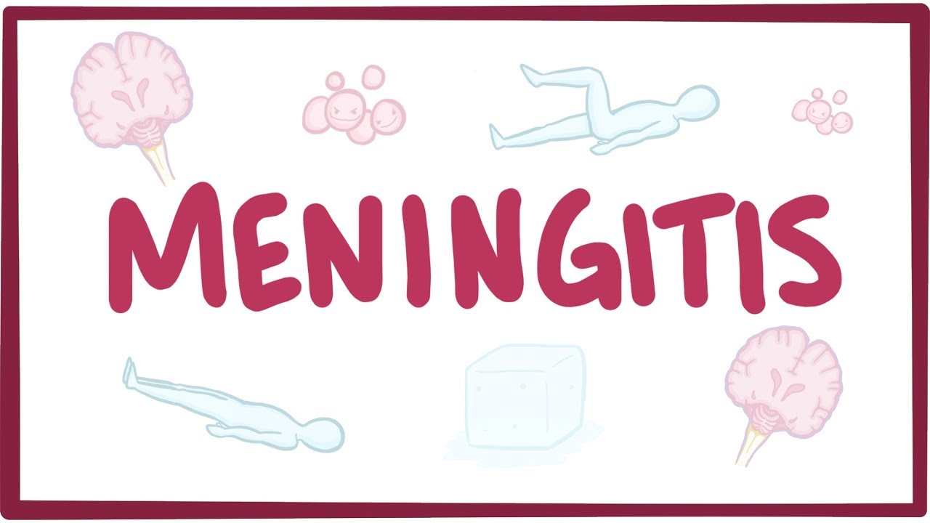
Adult Nursing Second Stage
م.م. فاطمة جبر

Slide 2
Introduction
The meninges is ﬁbrous connective tissues that cover the brain and spinal cord, provide protection, support, and nourishment. The layers of the meninges are the dura mater, arachnoid, and pia mater

Slide 3
Meningitis
Is an inflammation of the lining around the brain and spinal cord caused by bacteria or viruses. It is classified as septic or aseptic. Septic meningitis is caused by bacteria such as Streptococcus pneumonia and Neisseria meningitides that are responsible for 80% of cases of meningitis in adults

Slide 4
Meningitis
In aseptic meningitis, the cause is viral or secondary to lymphoma, leukemia, or human immunodeﬁciency virus (HIV).

Slide 5
Risk factors of bacterial meningitis
1. Tobacco use and viral upper respiratory infection, because they increase the amount of droplet production.
2. Otitis media and mastoiditis, because the bacteria can cross the epithelial membrane and enter the subarachnoid space.
3. People with immune system deﬁciencies are also at greater risk for development of bacterial meningitis.

Slide 7
Pathophysiology
Meningeal infections generally originate in one of two ways: through the bloodstream from other infections or by direct extension (after a traumatic injury to the facial bones or secondary to invasive procedures).

Slide 8
Pathophysiology

Slide 9
Pathophysiology
Once the causative organism enters the bloodstream, it crosses the blood brain barrier and proliferates in the cerebrospinal ﬂuid (CSF). The host immune response stimulates the release of cell wall fragments and lipopolysaccharides, facilitating inﬂammation of the subarachnoid and pia mater.

Slide 10
Pathophysiology
Because the cranial vault contains little room for expansion, the inﬂammation may cause increased intracranial pressure (ICP). CSF circulates through the subarachnoid space, where inﬂammatory cellular materials from the affected meningeal tissue enter and accumulate.

Slide 11
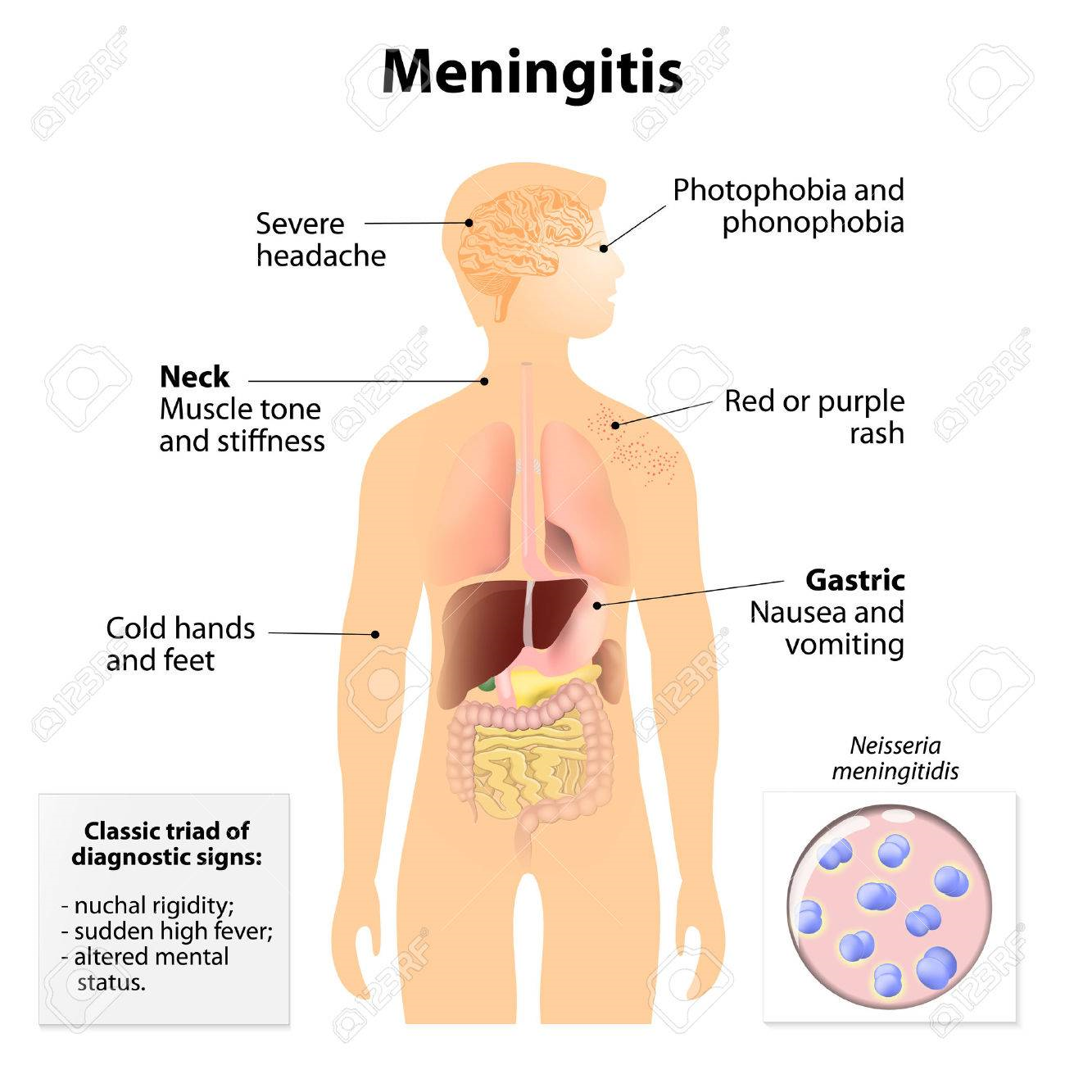

Slide 12
Clinical Manifestations
A. Headache and fever are frequently the initial symptoms. Fever tends to remain high throughout the course of the illness. The headache is usually either steady or throbbing and very severe as a result of meningeal irritation

Slide 13
Clinical Manifestations
B. Meningeal irritation signs:
1. A stiff and painful neck (nuchal rigidity) can be an early sign and any attempts at ﬂexion of the head are difﬁcult because of spasms in the muscles of the neck.

Slide 14
Clinical Manifestations
2. Positive Kernig’s sign: When the patient is lying with the thigh ﬂexed on the abdomen, the leg cannot be completely extended

Slide 15
Clinical Manifestations

Slide 16
Clinical Manifestations
3. Positive Brudzinski’s sign: When the patient’s neck is flexed (after ruling out cervical trauma or injury), ﬂexion of the knees and hips is produced. It is a more sensitive indicator of meningeal irritation than Kernig’s sign.

Slide 17
Clinical Manifestations

Slide 18
Clinical Manifestations
4. Photophobia (extreme sensitivity to light): This ﬁnding is common.
5. A rash (N. meningitidis) infection ranging from a petechial rash with purpuric lesions to large areas of ecchymosis.

Slide 19
Clinical Manifestations
6. Disorientation and memory impairment are common early in the course of the illness.
7. Behavioral manifestations are also common. As the illness progresses, lethargy, unresponsiveness, and coma may develop.
8. Seizures.

Slide 20
Clinical Manifestations
9. ICP increases secondary to diffuse brain swelling or hydrocephalus. The initial signs of increased ICP include decreased level of consciousness and focal motor deﬁcits. If ICP is not controlled, the temporal lobe may herniate, causing pressure on the brain stem. Brain stem herniation is a life-threatening event that causes cranial nerve dysfunction and depresses the centers of vital functions, such as the medulla.

Slide 21
Clinical Manifestations
10. An acute fulminant infection occurs in about 10% of patients with meningococcal meningitis, producing signs of over whelming septicemia: an abrupt onset of high fever,extensive purpuric lesions (over the face and extremities), shock, and signs of disseminated intravascular coagulation (DIC). Death may occur within a few hours after onset of the infection.

Slide 22
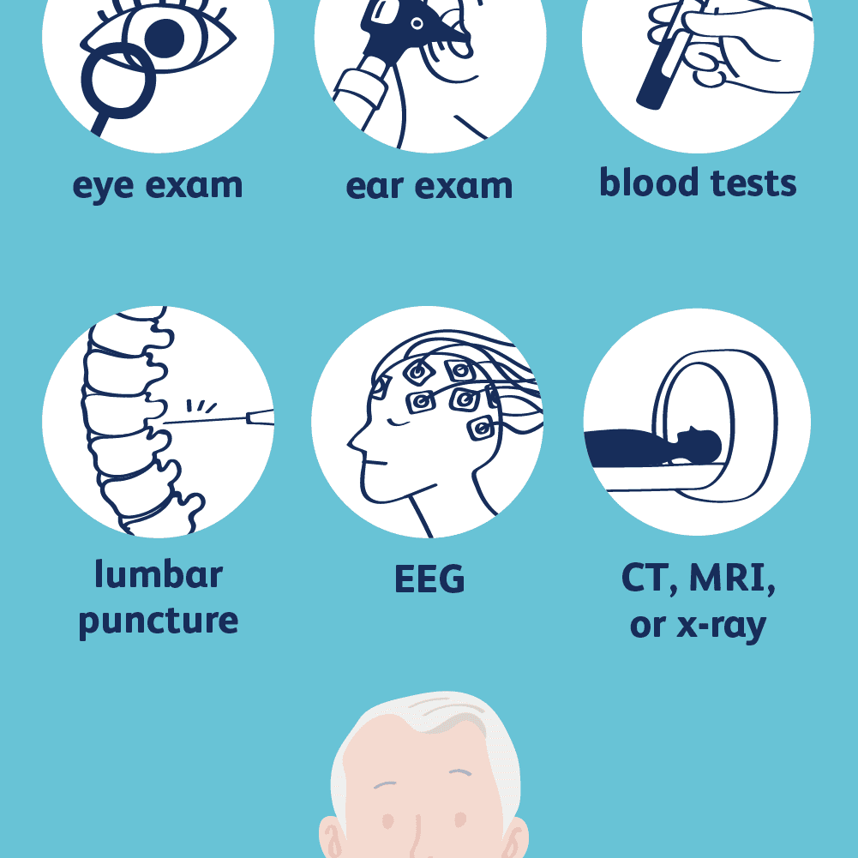
Assessment and Diagnostic Findings

Slide 23
Assessment and Diagnostic Findings
clinical presentation that suggests meningitis.
complete blood count (CBC): elevated leukocyte count
a lumbar puncture: elevated CSF pressure, cloudy or milky white CSF, low glucose, high protein levels, and high white blood cell count.

Slide 24
Assessment and Diagnostic Findings
4. Bacterial culture and Gram staining of CSF and blood are key diagnostic tests.
5. CT scan or magnetic resonance imaging (MRI) scan is used to detect a shift in brain contents (which may lead to herniation) and rules out cerebral hematoma, hemorrhage or tumor

Slide 25
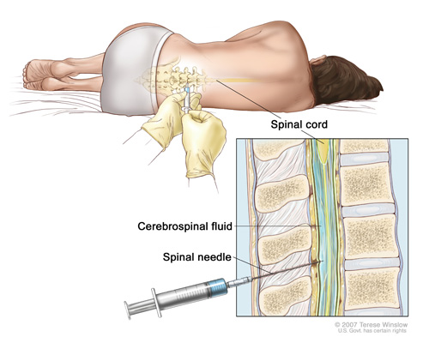
Assessment and Diagnostic Findings

Slide 27
Prevention
1. People in close contact with patients with meningococcal meningitis should be treated with antimicrobial chemoprophylaxis using rifampin (Rifadin), ciprofloxacin hydrochloride (Cipro). Therapy should be started within 24 hours after exposure
2. Vaccination should also be considered as an adjunct to antibiotic chemoprophylaxis for anyone living with a person who develops meningococcal infection.
3. Vaccination against H. inﬂuenzae and S. pneumoniae for children and at-risk adults

Slide 28
Medical Management
- Patient treated with antibiotics and vigorous supportive care.
- IV antibiotics are given for at least 2 weeks, followed by oral antibiotics.(Vancomycin hydrochloride in combination with one of the cephalosporins (eg, ceftriaxone sodium, cefotaxime sodium)

Slide 29
Medical Management
Dexamethasone (Decadron) as adjunctive therapy.
Mannitol to decrease cerebral edema.
Phenytoin to control seizures.
Acetaminophen to relieve headache and fever.
Supportive measures: bed rest and fluid therapy to prevent dehydration.
Isolation

Slide 30
Medical Management
- Treatment for any coexisting conditions such as pneumonia
- Antifungal agents for cryptococcal meningitis

Slide 31
Nursing Management
1. Instituting infection control precautions until 24 hours after initiation of antibiotic therapy (oral and nasal discharge is considered infectious)
2. Neurologic status and vital signs are continually assessed.
3. Pulse oximetry and arterial blood gas values are used to quickly identify the need for respiratory support .

Slide 32
Nursing Management
4. Insertion of a cuffed endotracheal tube (or tracheotomy) and mechanical ventilation may be necessary to maintain adequate tissue oxygenation
5. Blood pressure is assessed for incipient shock, which precedes cardiac or respiratory failure.

Slide 33
Nursing Management
6. Rapid IV ﬂuid replacement may be prescribed, but care is taken to prevent ﬂuid overload.
7. Reduce high Fever.
8. Protecting the patient from injury secondary to seizure activity or altered LOC

Slide 34
Nursing Management
9. Monitoring daily body weight; serum electrolytes; and urine volume, speciﬁc gravity, and osmolality, especially if syndrome of inappropriate antidiuretic hormone (SIADH) is suspected

Slide 35
Nursing Management
10. Preventing complications associated with immobility, such as pressure ulcers and pneumonia
11. the family needs to be informed about the patient’s condition

Slide 36
Complications
*Shock/Sepsis *Cerebral edema
*Subdural empyema *Ventriculitis
*Abscess *Seizures
*Death *Visual impairment

